Slide 1
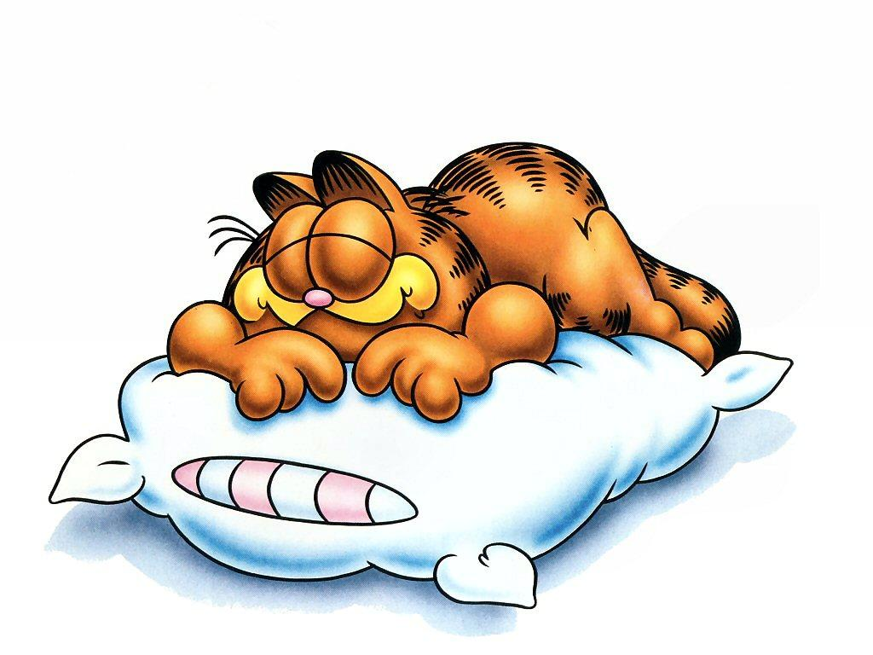
On Monday I’m sleepy

Slide 2

On Tuesday I’m glad

Slide 3
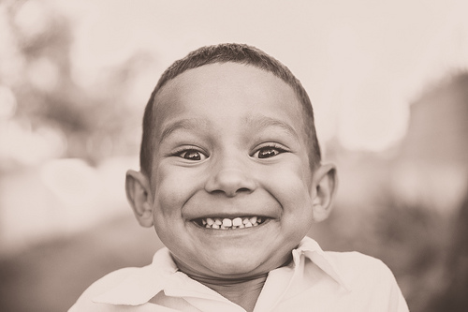
On Wednesday I’m happy

Slide 4
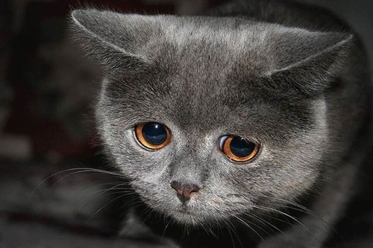
On Thursday I’m sad

Slide 5
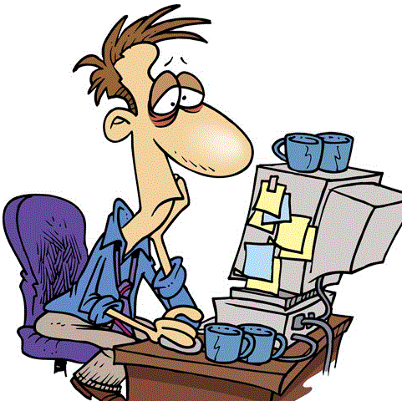
On Friday I’m tired,
I don’t want to work

Slide 6
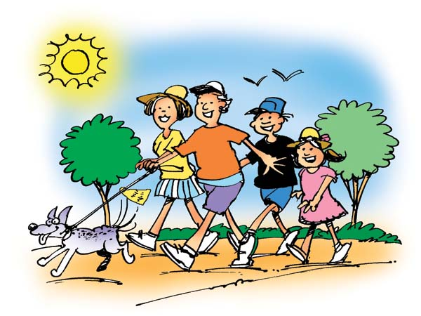
On Saturday and Sunday
I go for a walk

