Slide 1
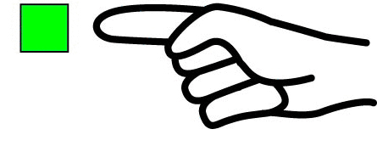
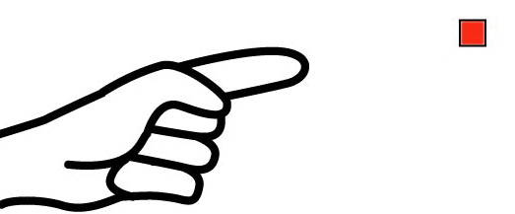
This is
These are
That is
Those are

Slide 2
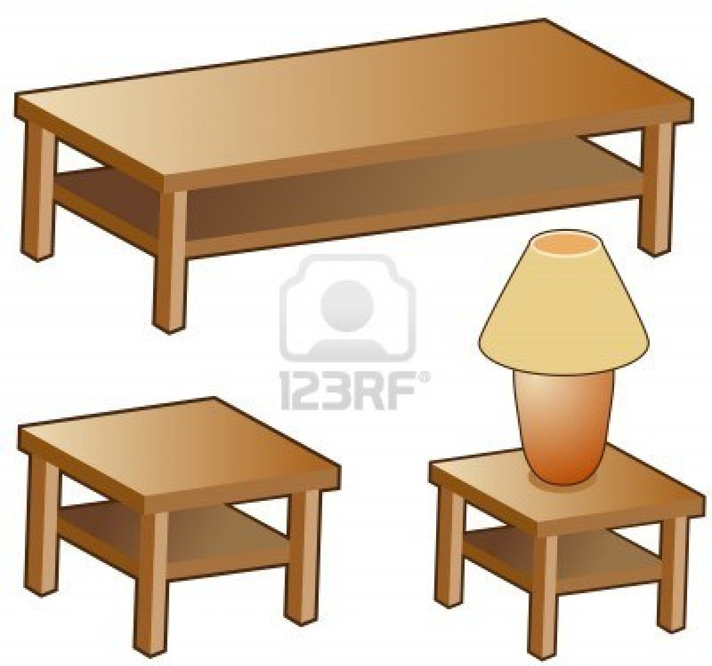
These are tables.

Slide 3
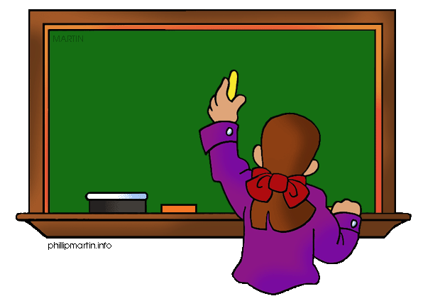
That is a board.

Slide 4

Those are computers.

Slide 5
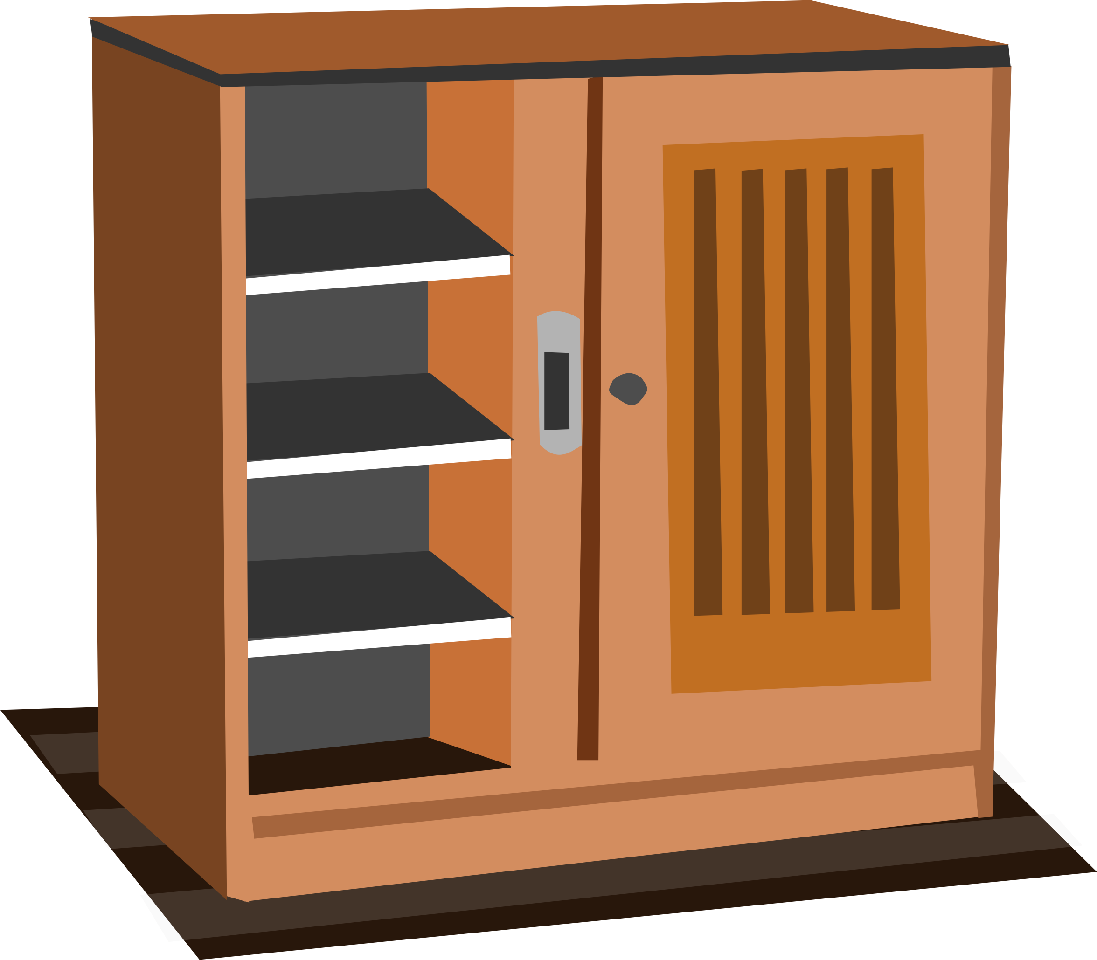
This is a cupboard.

Slide 6
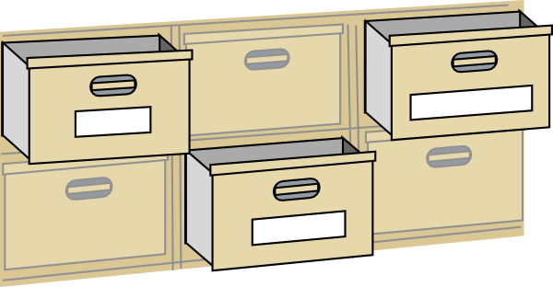
These are drawers.

Slide 7
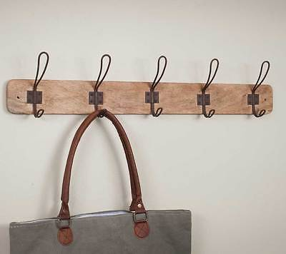
Those are pegs.

Slide 8
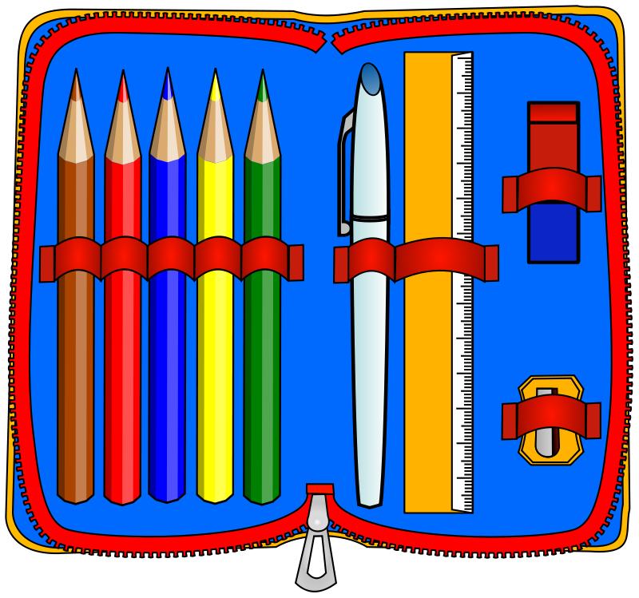
That is a pencil case.

Slide 9

This is a picture.

Slide 10
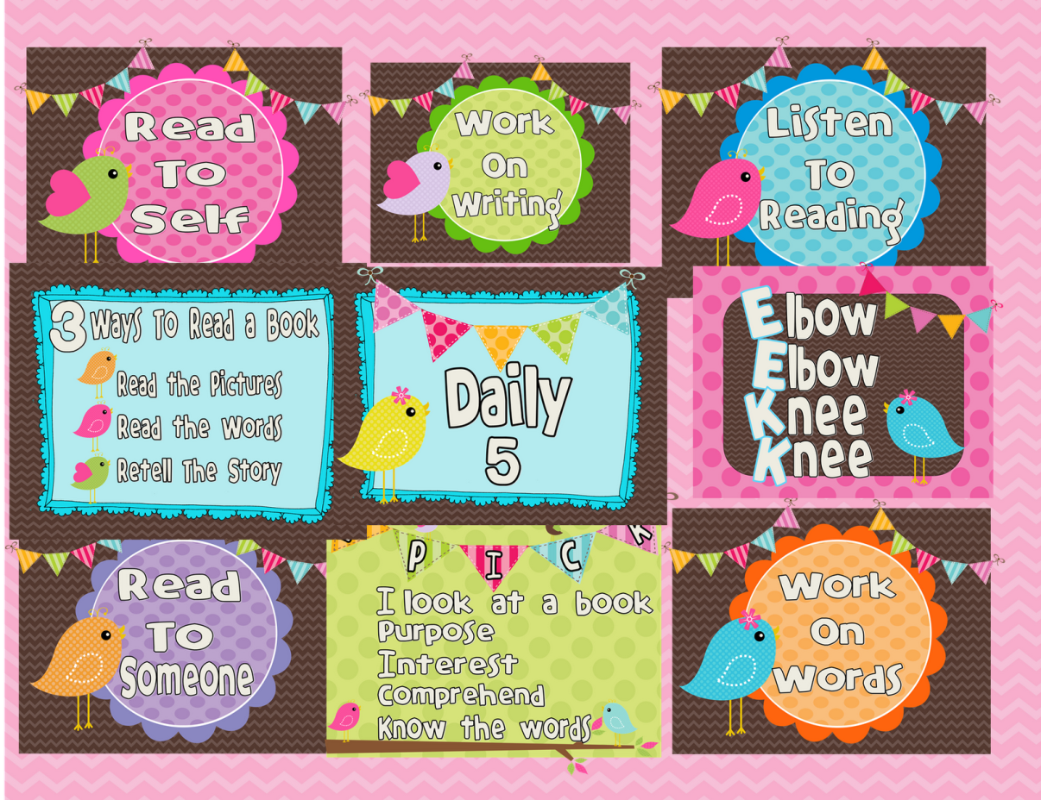
Those are posters.

Slide 11
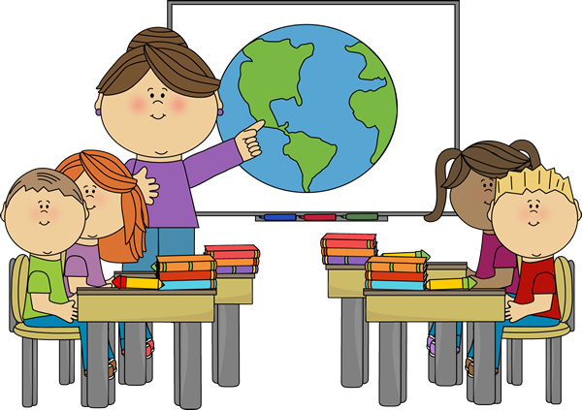
This is a classroom.

