Slide 1
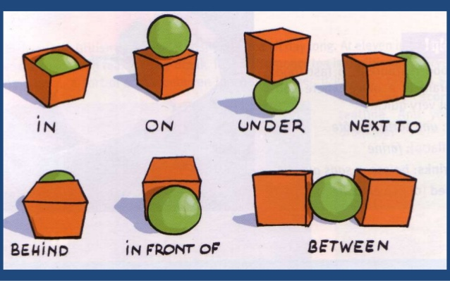

Slide 2
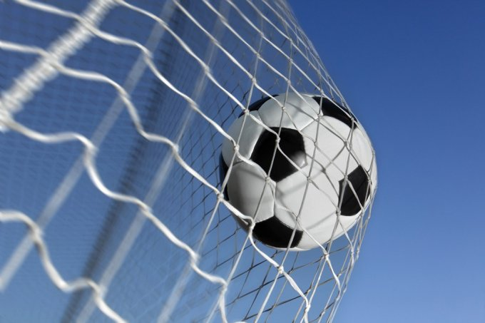
Where is the ball?
The ball is in the net.

Slide 3


Slide 4
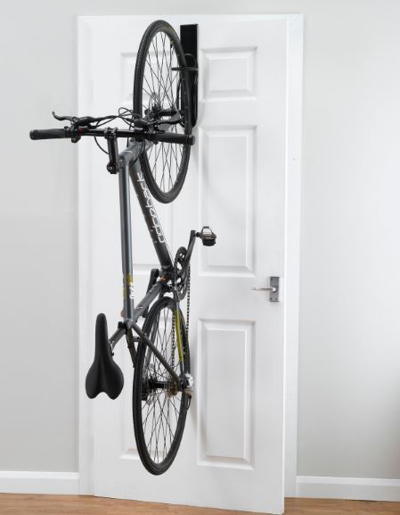

Slide 5


Slide 6


Slide 7
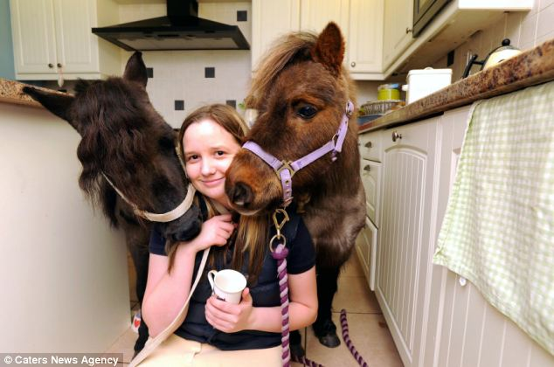

Slide 8


